Slide 1
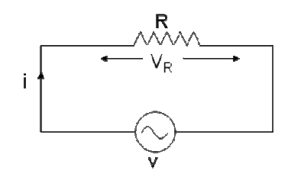

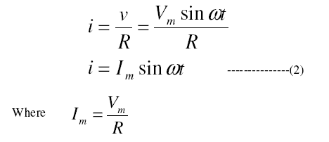
AC circuit with a pure Resistor:
From equation (1) and (2) we conclude that in a pure resistive circuit, the voltage and current are in phase.

Slide 2
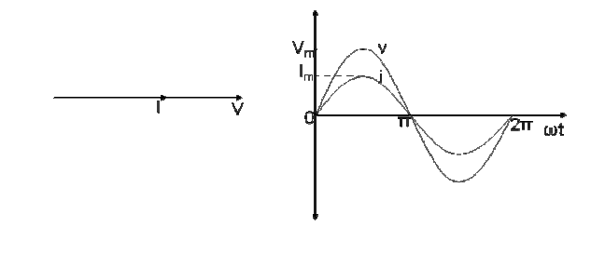
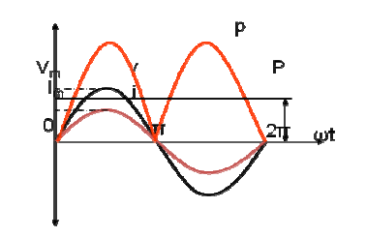
V in phase with I

Slide 3
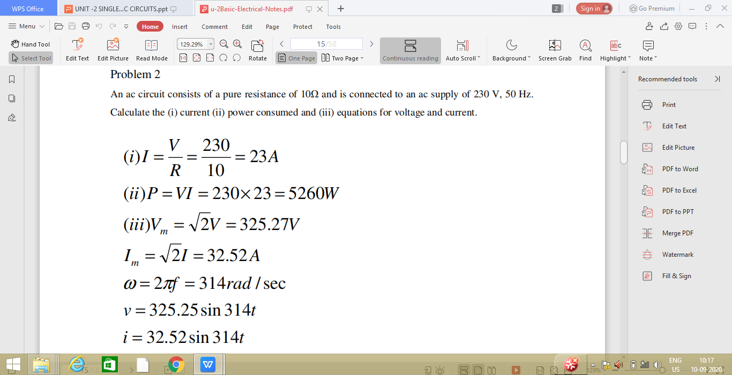

Slide 4
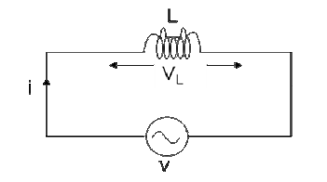

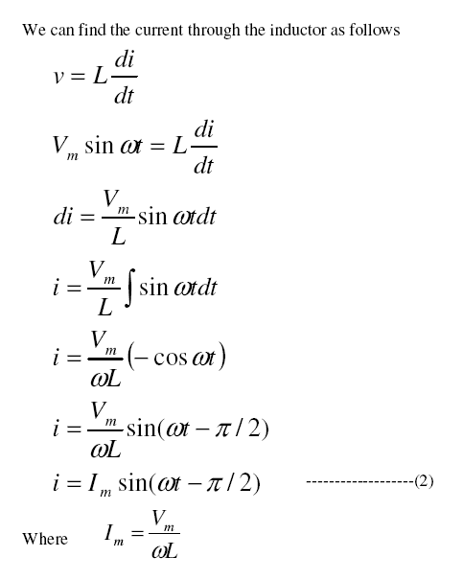
AC circuit with a pure Inductor:

Slide 5
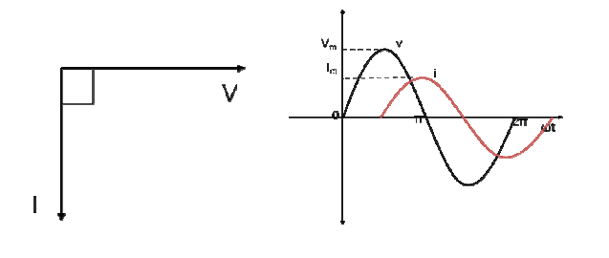

From equation (1) and (2) we observe that in a pure inductive circuit, the current lags behind the voltage by 90⁰. Hence the voltage and current waveforms and phasors can be drawn as below.

Slide 6
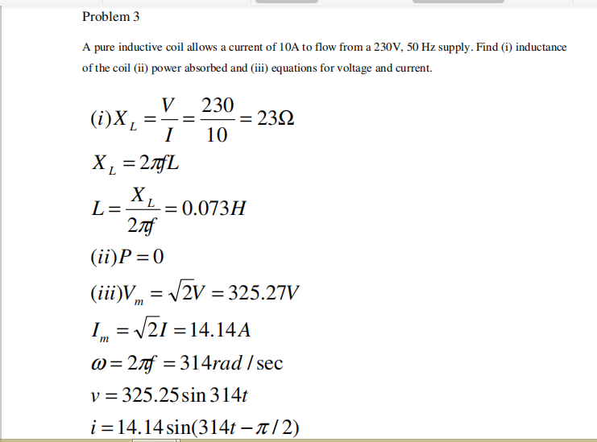

Slide 7
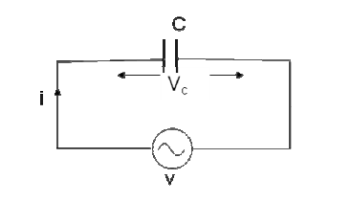

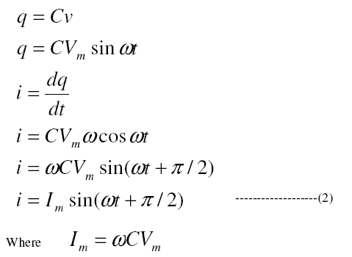
AC circuit with a pure Capacitor:

Slide 8
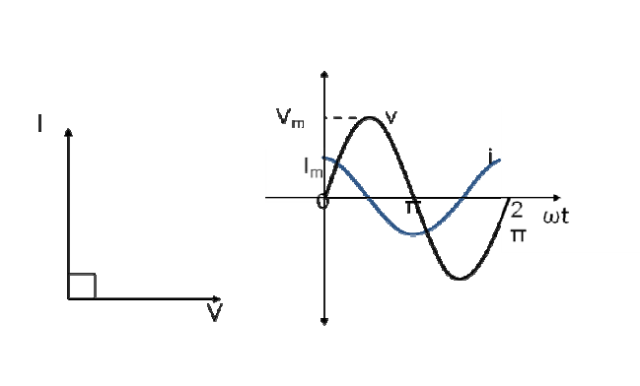
From equation (1) and (2) we observe that in a pure capacitive circuit, the current leads the voltage by 90⁰.
Hence the voltage and current waveforms and phasors can be drawn as below.

Slide 9
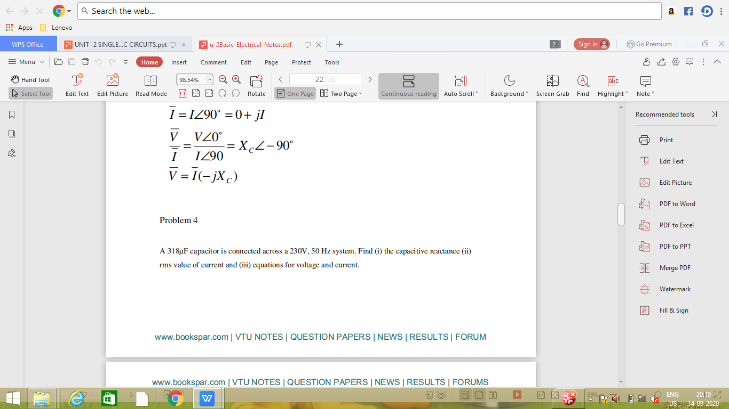
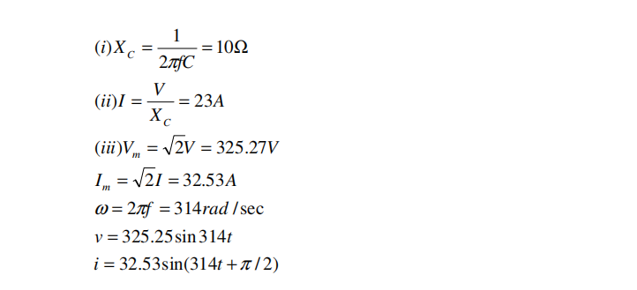

Slide 10
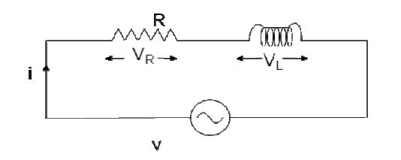


R-L circuit:
Consider an AC circuit with a resistance R and an inductance L connected in series as shown in the figure. The alternating voltage v is given by
The current flowing in the circuit is i. The voltage across the resistor is VR and that across the inductor is VL.

Slide 11
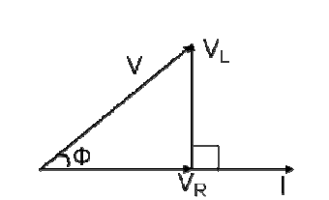
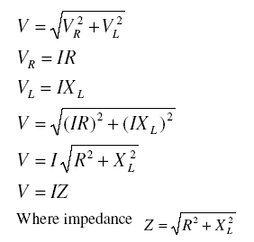
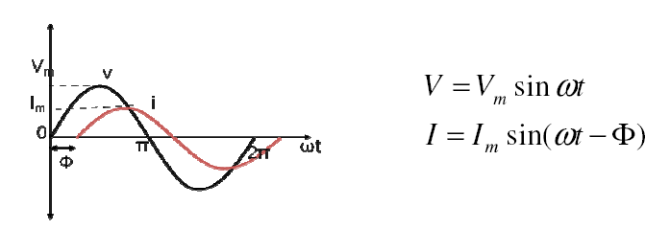

Slide 12
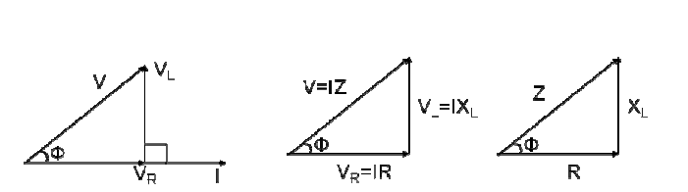
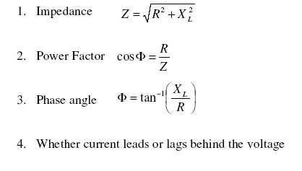
Impedance triangle :

Slide 13
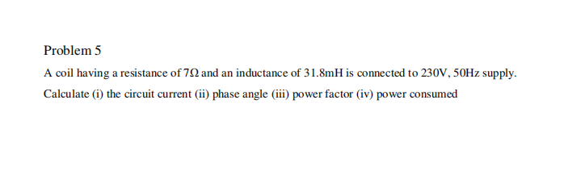
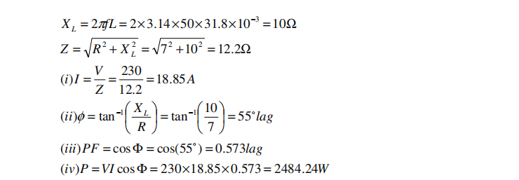

Slide 14
Power:
In an AC circuit, the various powers can be classified as
1. Real or Active power
2. Reactive power
3. Apparent power
Real or active power in an AC circuit is the power that does useful work in the circuit.
Reactive power flows in an AC circuit but does not do any useful work.
Apparent power is the total power in an AC circuit.

Slide 15
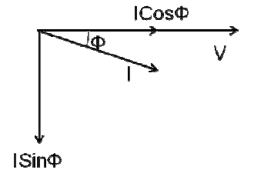
From the phasor diagram of an RL series circuit, the current can be divided into two components.
One component along the voltage IcosΦ, that is called as the active component of current and another component perpendicular to the voltage IsinΦ that is called as the reactive component of current.

Slide 16
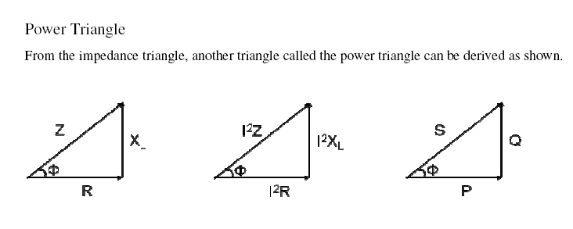
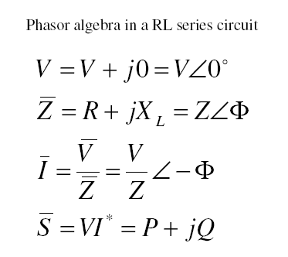
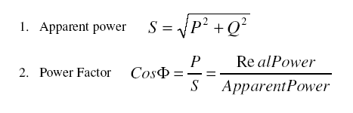

Slide 17
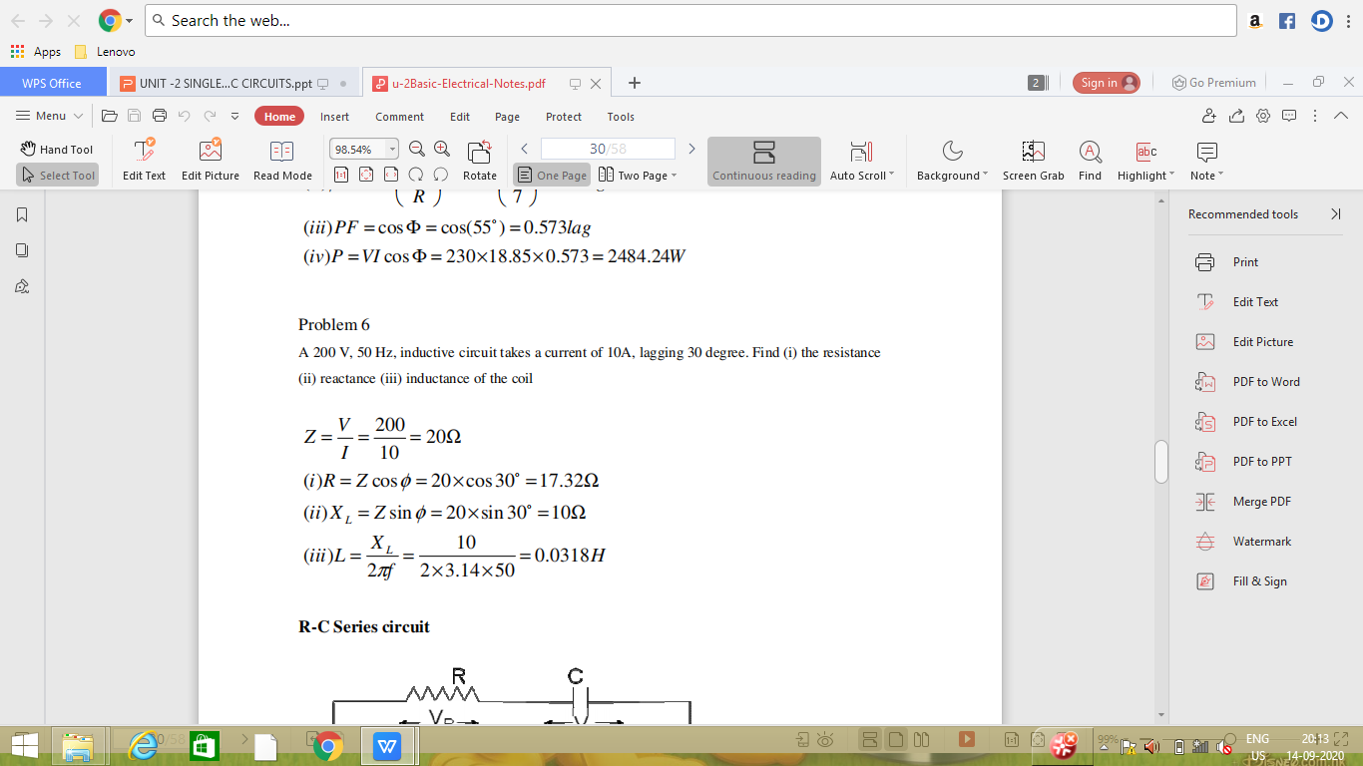

Slide 18
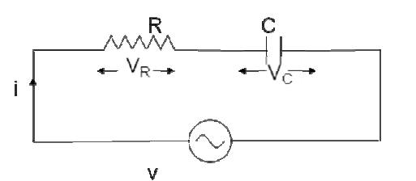


R-C circuit:
Consider an AC circuit with a resistance R and a capacitance C connected in series as shown in the figure. The alternating voltage v is given by
The current flowing in the circuit is i. The voltage across the resistor is VR and that across the capacitor is VC.

Slide 19
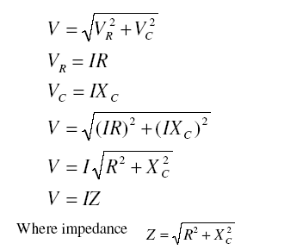
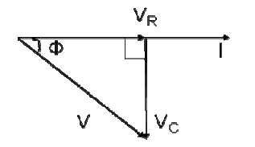
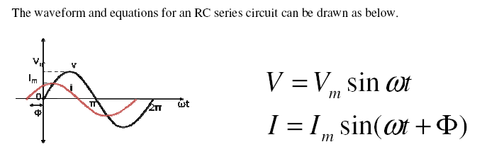

Slide 20
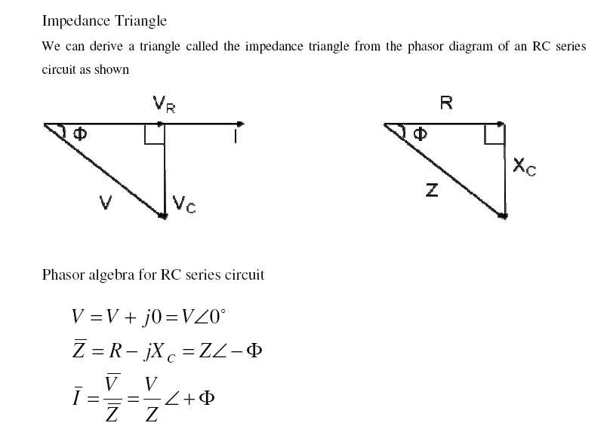

Slide 21
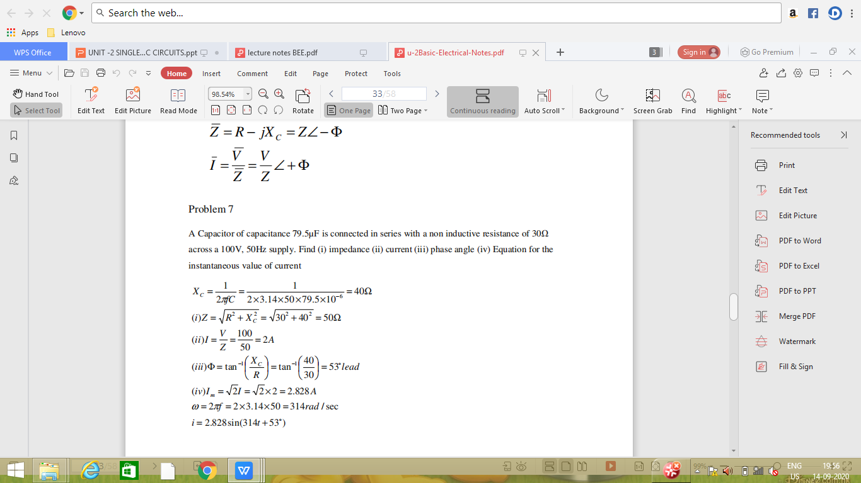

Slide 22
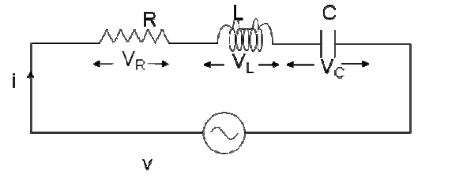
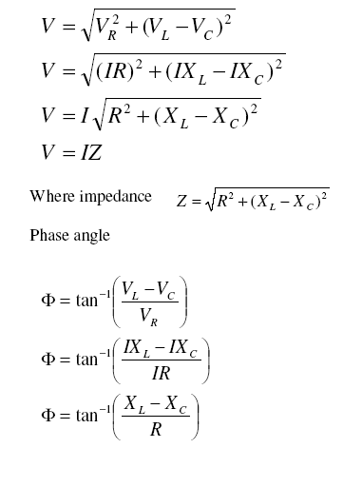
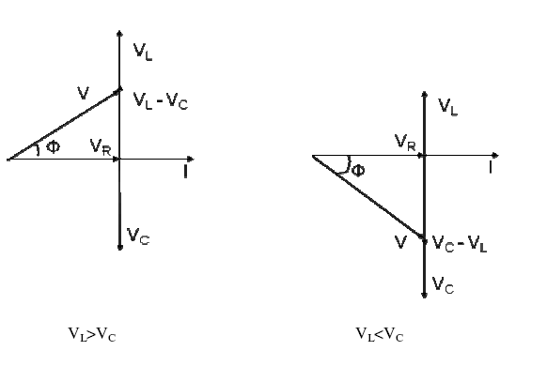
R-L-C Series circuit

Slide 23
From the expression for phase angle, we can derive the following three cases
Case (i): When XL>XC
The phase angle Φ is positive and the circuit is inductive. The circuit behaves like a series RL circuit.
Case (ii): When XL<XC
The phase angle is negative and the circuit is capacitive. The circuit behaves like a series RC circuit.
Case (iii): When XL=XC
The phase angle Φ = 0 and the circuit is purely resistive. The circuit behaves like a pure resistive circuit.

Slide 24
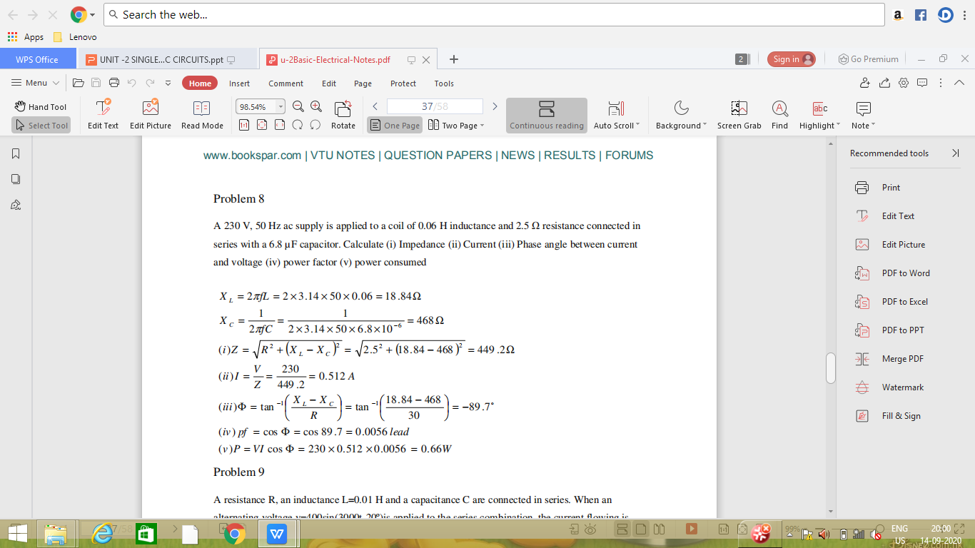

Slide 25
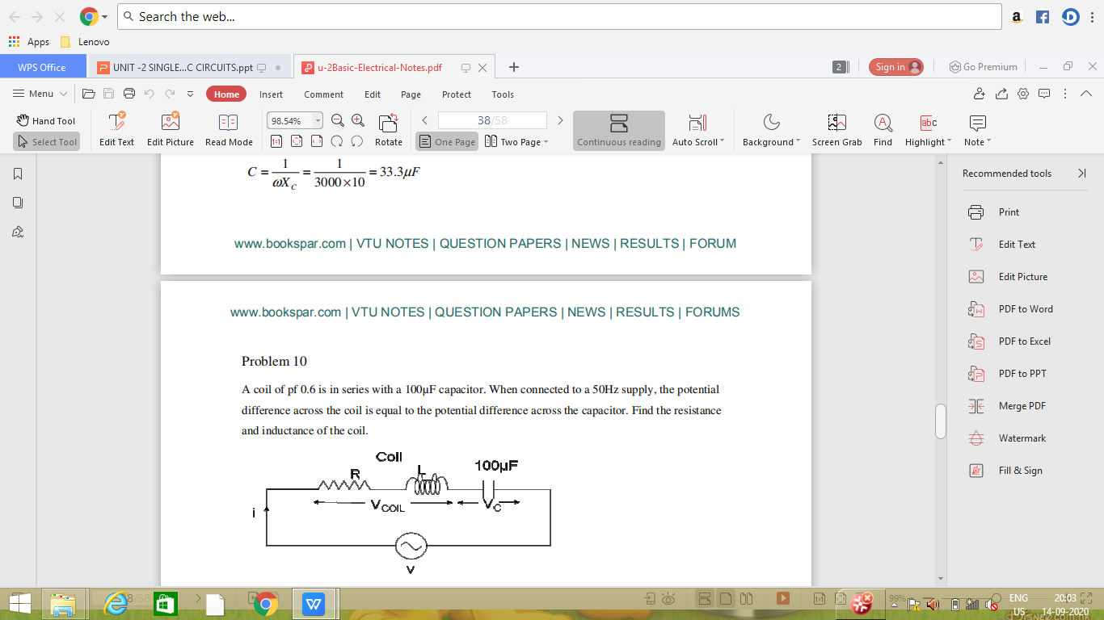

Slide 26
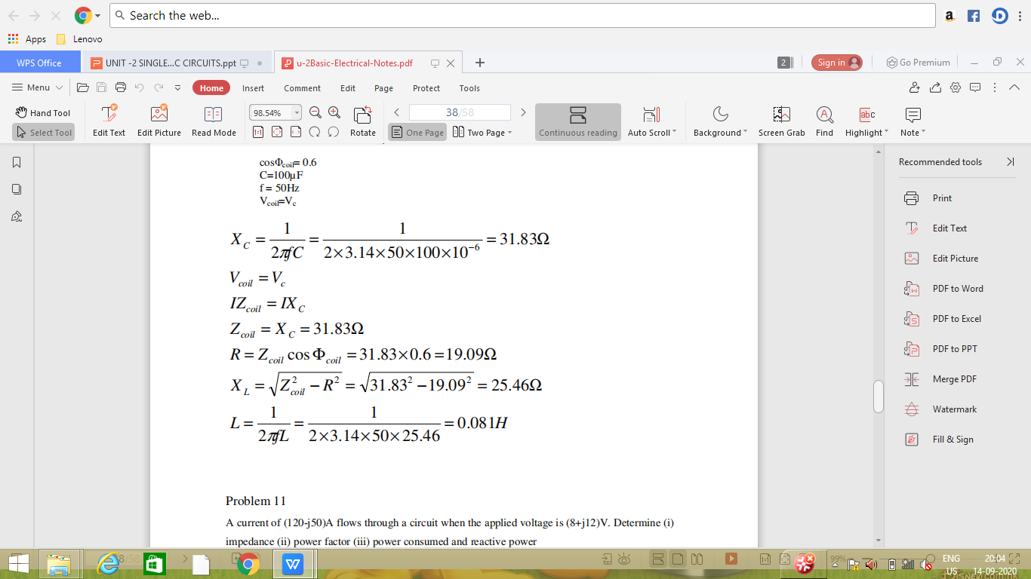

Slide 27
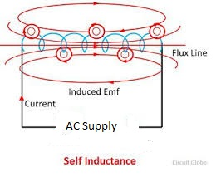
Self and Mutual Inductances
Inductance: It is the property of the electric conductor by which the change in current produces an electromotive force (EMF) based on faraday's laws.
I. Self Inductance: the rate of change of flux produce emf in same coil is called self inductance.
The induced emf (voltage) produced in a coil is directly proportional to the rate of change of current

Slide 28
(1) , self inductance
this negative sign because of lenz’s law, according to lenz’s law the generated emf opposes the rate of change of current through which it is generated.
The current is time varying, is produced time varying magnetic flux , this flux produce emf in the coil.
According to farady’s law (2),
N-no. of turns.
Compare equation (1) & (2)
, , - flux linkage

Slide 29
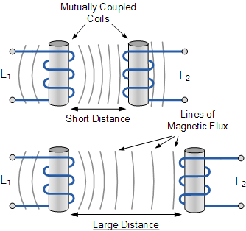
II. Mutual Inductance: the rate of change of flux produce emf in near by the coil is called mutual inductance.
The flux generated in coil 1 is link with coil 2 and produced emf in coil 2. Where is the flux link with coil 2.
According to farady’s law (1), is directly proportional to rate of change of current in coil 1.

Slide 30
(2), M- Mutual inductance, than compare equation (1) & (2),
this is mutual inductance, when current is flowing in coil 1. Similarly the mutual inductance, when current is flowing in coil 2 is given

Slide 31
UNIT-II
SINGLE PHASE AC CIRCUITS
PART A IMPORTANT QUESTIONS SHORT ANSWER TYPE
1. Discuss the significance of j operator?
2.Define faradays laws of electromagnetic induction?
3.Define self, mutual inductances?
4.What is meant by power factor? Draw power factor Triangle?
5.Define Real Power, Reactive Power and Apparent Power?

Slide 32
PART B
1.Explain the terms (a) Instantaneous value (b) Cycle (c) Time Period (d) Periodic Function(e) Frequency (f) Angular Frequency
2. Derive the expression for current, impedance, phase angle and power for
R-L series circuit with phasor diagram.
3. Derive the expression for current, impedance, phase angle and power for
R-c series circuit with phasor diagram.
4.Explain the behavior of an AC circuit consisting of a pure resistor, inductor and capacitor with phasor diagrams?
5.Derive expression of R.M.S value,Average value,Form factor,peak factor of alternating quantity of sinusoidal waveform

Slide 33
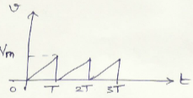
PART C
1.An alternating current ‘I’ is given by i = 141.4 sin 314t. Find i) The maximum value ii) Frequency iii) Time Period iv) The instantaneous value when t=3ms
2.Determine the average value, rms value, form factor and peak factor of the current waveform in Figure.
3.A pure inductive coil allows a current of 10A to flow from a 230V, 50 Hz supply. Find (i) impedance of the circuit and (ii) inductance of the coil

Slide 34
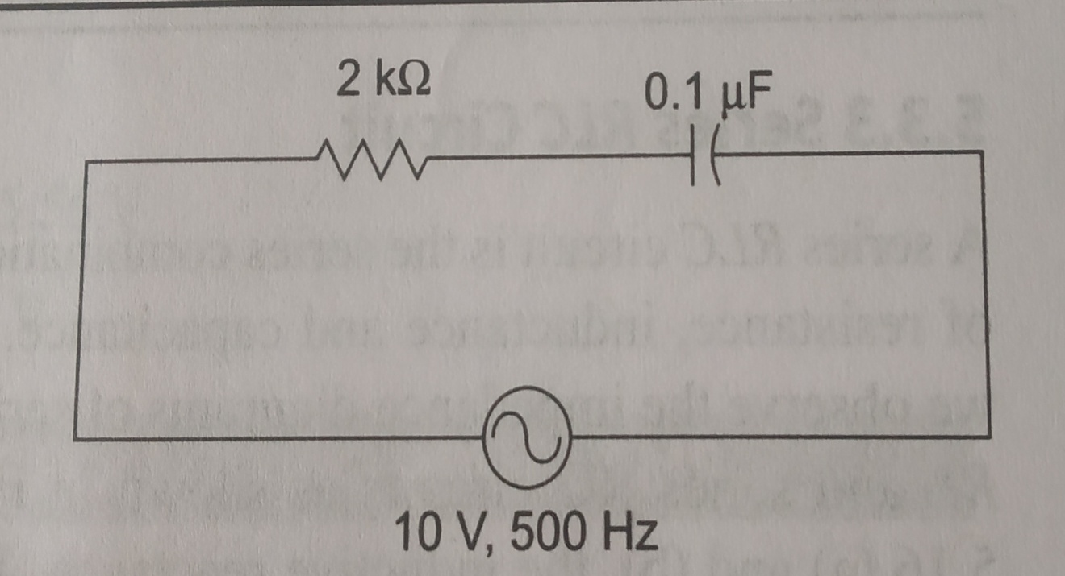
Problem 4: Find impedance, current, phase angle, voltage across resistance and capacitance of the circuit.

Slide 35
5.

